Slide 1
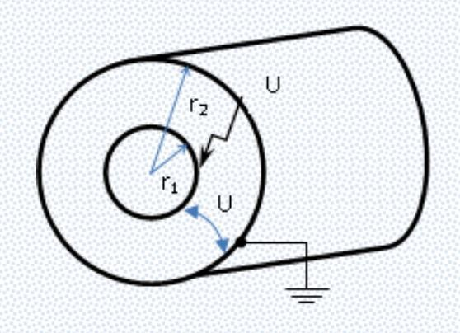
New Topic:
EE4047 – High Voltage Techniques I
Cylindrical Electrode Systems
Week 9.2 – Thursday Lesson
Asst. Prof. Dr. M. Alparslan Zehir
27.04.2023

Slide 2






OUTLINE
1
Introduction to Cylindrical Electrodes
2
3
4
Coaxial Cylindrical Electrode Systems
Multilayer Dielectric Coaxial Cylinders
Breakdown Behavior in Cylinderical Electrodes Systems
1

Slide 3



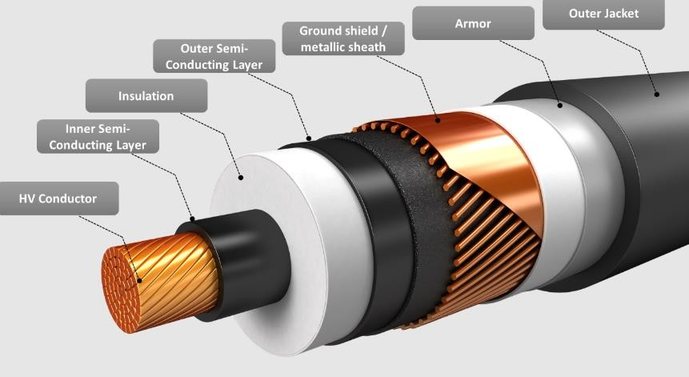
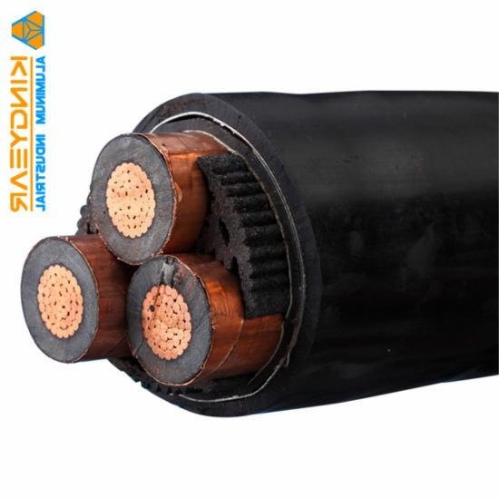
INTRODUCTION TO CYLINDRICAL ELECTRODES
1
Two or more cylindrical electrodes with dielectric material between them form a cylindrical electrode system.
If they share the same axis, it is called coaxial, such as cables
and bushings.
They may also be next to each other or crosswise like in
transmission lines.
Moreover, many systems that have axial symmetry can be considered as a symmetrical electrode system. Some examples are motors, generators, transformers isolators, an overhead line and a ground.
The important parameters are electric field strength, electric flux density, potential and capacity.

Slide 4
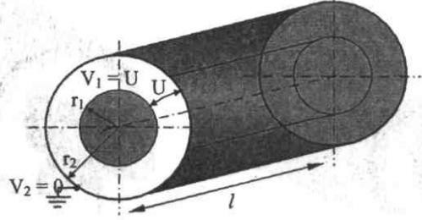
COAXIAL CYLINDRICAL ELECTRODE SYSTEMS
2
Coaxial cylindrical electrode system forms the basis of cylindrical electrode systems.
Consider the system given in the figure with two electrodes with different radius values 𝑟₁and 𝑟₂
and the same length, 𝑙. The voltage applied to the inner electrode is 𝑈.
The potential on any point of the dielectric material changes in 3D in reality. However, due to axial symmetry, it can be
analyzed in one dimension depending on 𝑟.
Considering a cylindrical coordinate system,
a Laplace equation that depends only on 𝑟 can be solved.

Slide 5
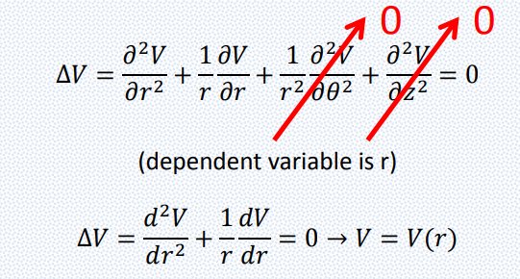
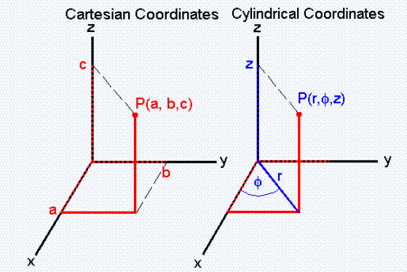

COAXIAL CYLINDRICAL ELECTRODE SYSTEMS
2
Considering a cylindrical coordinate system, a Laplace equation that depends only on 𝑟 can be solved.
Giving the boundary conditions as 𝑟 = 𝑟₁
𝑉 = 𝑈 and 𝑟 = 𝑟₂
𝑉 = 0
𝑉 =
𝑈
𝑙𝑛 ^{𝑟2} with the relation 𝐸 = −𝑔𝑟𝑎𝑑 𝑉 E =
𝑟
𝑈 1
𝑙𝑛^{𝑟2}
𝑙𝑛^{𝑟2} 𝑟
𝑟₁
𝑟₁

Slide 6
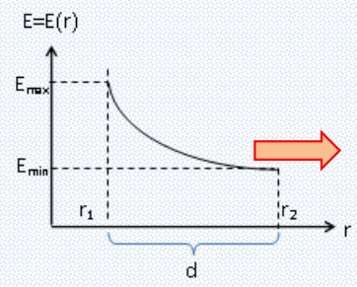
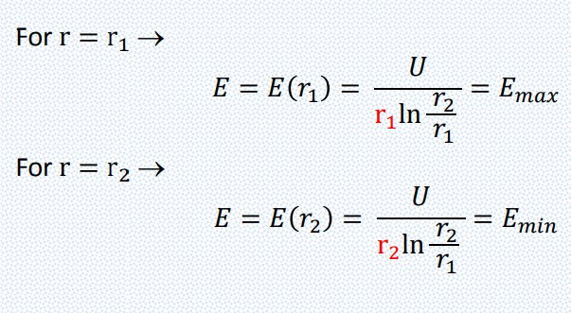
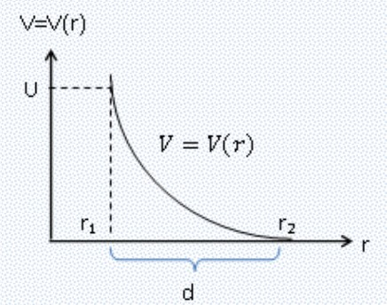

COAXIAL CYLINDRICAL ELECTRODE SYSTEMS
2
𝑉 =
𝑈
𝑙𝑛 ^{𝑟2}
E =
𝑈 1
𝑙𝑛^{𝑟2}
𝑟
𝑙𝑛^{𝑟2} 𝑟
𝑟₁
𝑟₁

Slide 7
COAXIAL CYLINDRICAL ELECTRODE SYSTEMS
2
𝑈 1
^{𝐸}𝑎𝑣𝑒 ⁼
𝑟_{2 𝑟}
𝑙𝑛 _{𝑟}
𝑎𝑣𝑒
1
𝑟₂ − 𝑟₁
𝑟 =
𝑎𝑣𝑒
𝑙𝑛 ^{𝑟2}
𝑟₁

Slide 8
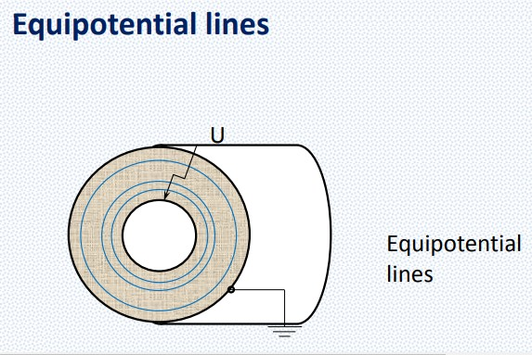
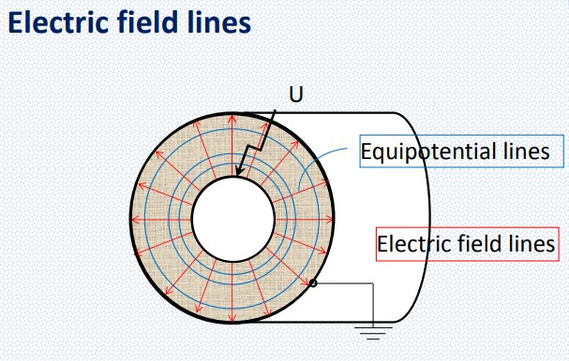
COAXIAL CYLINDRICAL ELECTRODE SYSTEMS
2

Slide 9
COAXIAL CYLINDRICAL ELECTRODE SYSTEMS
2
The electric flux density can be calculated using the equation 𝐷 = 𝑄Τ𝑆
In the place of S, we can use the surface area formula of a cylinder: 𝑆 = 2π𝑟𝑙
𝑄
𝐷 =
2π𝑟𝑙
Using the relation 𝐷 = ε𝐸
𝑄 1 2πε𝑙 𝑟
𝐸 =
Integral of the electric field gives us the voltage across the electrodes (U).
𝑟₂
𝑈 = න 𝐸 𝑑𝑟 =
𝑟₁
𝑄 ^{𝑟2} 𝑑𝑟 𝑄 𝑟₂ න = 𝑙𝑛
2πε𝑙
𝑟 2πε𝑙 𝑟₁
𝑟₁

Slide 10
COAXIAL CYLINDRICAL ELECTRODE SYSTEMS
2
Capacity of a coaxial electrode system:
𝑄 2πε𝑙 2πε₀ε_{𝑟}𝑙
𝐶 = = =
𝑈
𝑙𝑛 ^{𝑟2} 𝑙𝑛 ^{𝑟2}
𝑟₁ 𝑟₁
In capacity calculations the unit for 𝑟₁ and 𝑟₂ is m, ε₀ = 8,854. 10⁻¹² F/m, so the result (C) will be
in Farad.

Slide 11
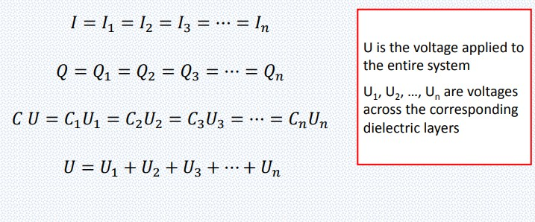
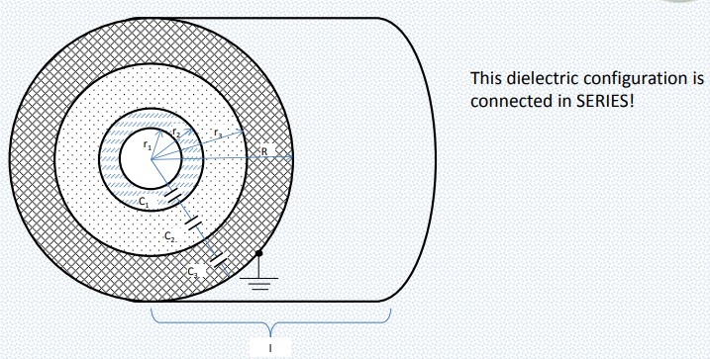
MULTILAYER DIELECTRIC COAXIAL CYLINDERS
3
Multilayer dielectric materials between the electrodes:
𝑙

Slide 12
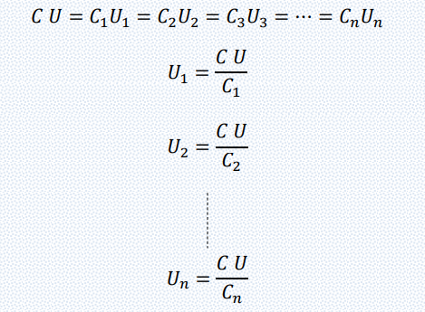
MULTILAYER DIELECTRIC COAXIAL CYLINDERS
3
Voltages across each dielectric layer:
𝑙

Slide 13
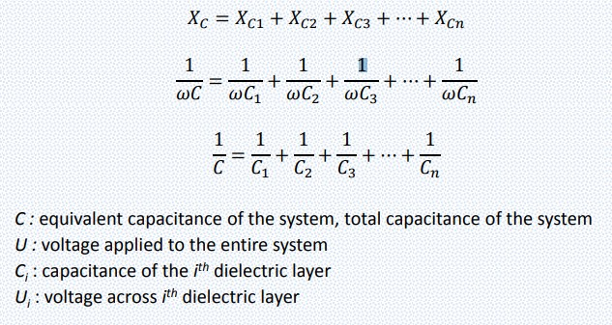
MULTILAYER DIELECTRIC COAXIAL CYLINDERS
3
Equivalent capacitance of the system:
𝑙

Slide 14

END OF THE LESSON
Any questions?
Check out the following two electric field videos on Youtube: https://www.youtube.com/watch?v=re6iFu5SIxY https://www.youtube.com/watch?v=mdulzEfQXDE
Check out our playlists on Youtube:
High Voltage Technique: https://www.youtube.com/playlist?list=PLLZI7WaEmZi04KMWVURGlU34W3LoNZyWX
Insulators: https://www.youtube.com/playlist?list=PLLZI7WaEmZi1ReLGq0qfP1VjRqxDJi5kA
Lightning Impulse Voltage: https://www.youtube.com/playlist?list=PLLZI7WaEmZi2isWOB-zBbb6LNplH28byQ
1

